Slide 1



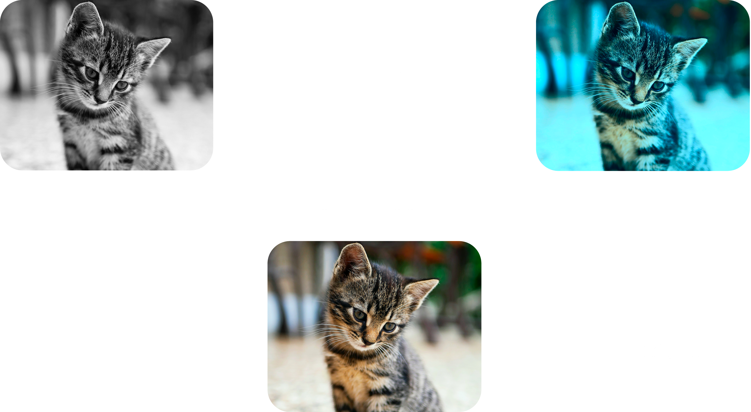
Momentum Contrast for Unsupervised Visual Representation Learning (CVPR 2020)
Authors: Facebook AI Research (FAIR)
Kaiming He, Haoqi Fan, Yuxin Wu, Saining Xie, Ross Girshick
Su Hyung Choi
Korea University
Research Intern @ CVLAB
Submitted on Jan 19, 2022

Slide 2
Era of Representation
Representation learning can be divided into:
Supervised representation learning: learning representations on task A using annotated data and used to solve task B
Unsupervised representation learning: learning representations on a task in an unsupervised way (label-free data). These are then used to address downstream tasks and reducing the need for annotated data when learning news tasks. Powerful models like GPT and BERT leverage unsupervised representation learning to tackle language tasks.
More recently, self-supervised learning (SSL) is one of the main drivers behind unsupervised representation learning in fields like computer vision and NLP.
From PapersWithCode (Facebook AI)

Slide 3
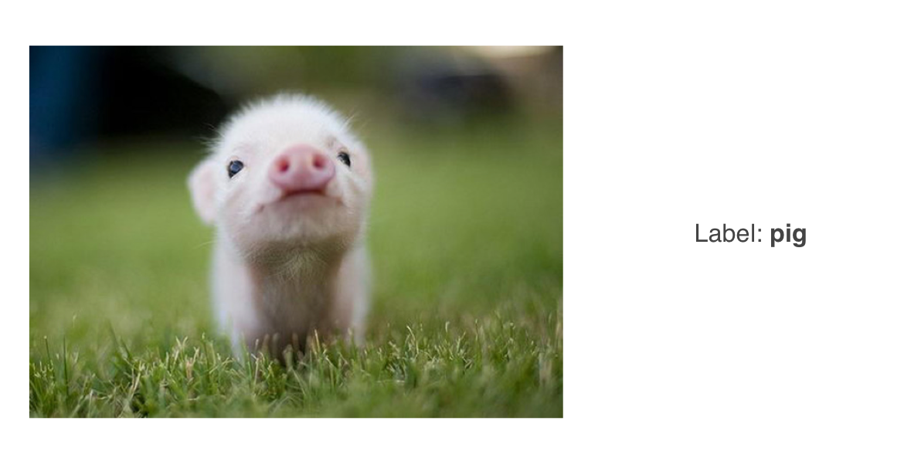
What is Self-Supervised Learning
Recall that in supervised learning, a system is given input (x) and a label (y)

Slide 4
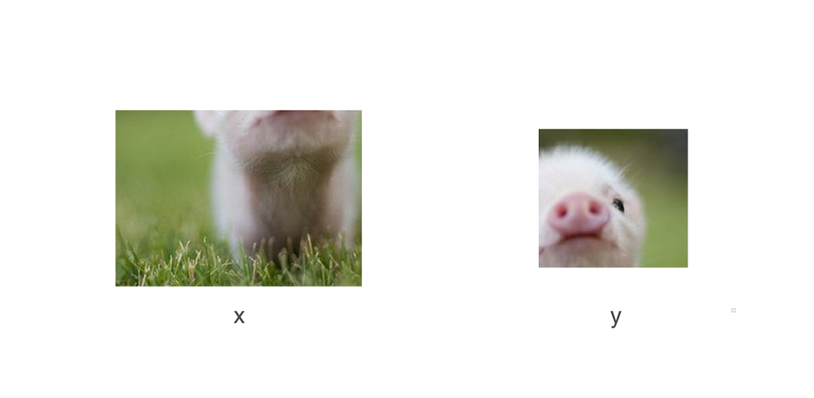
What is Self-Supervised Learning
In self-supervised learning, the system is only given (x).
Instead of a (y), the system “learns to predict part of its input from other parts of its input”

Slide 5
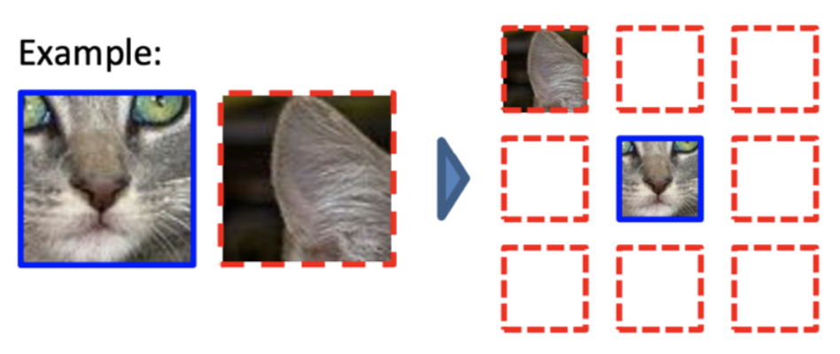
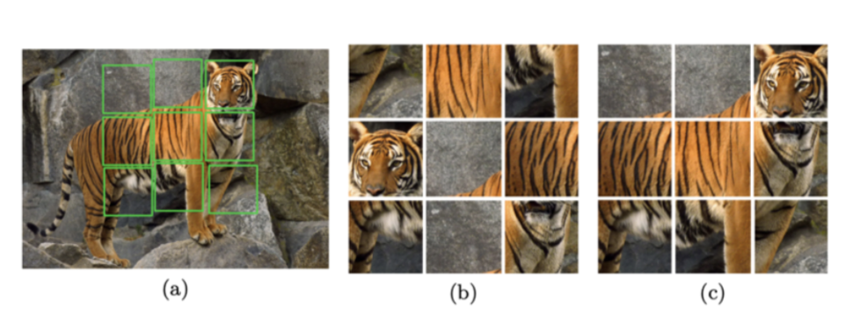
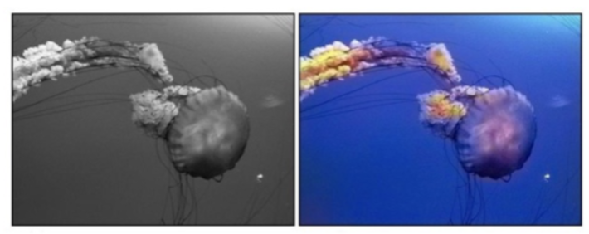
Pretext Tasks: creative strategies to “split” up the input
(1) Predicting relative locations of two patches
Unsupervised Visual Representation Learning by Context Prediction ICCV 2015
(2) solving a jigsaw puzzle
Unsupervised Learning of Visual Representations by Solving Jigsaw Puzzles ECCV 2016
Although the approaches above are full of creativity,
they don’t actually work well in practice.
(3) colorizing an image
Colorful Image Colorization CVPR 2016

Slide 6
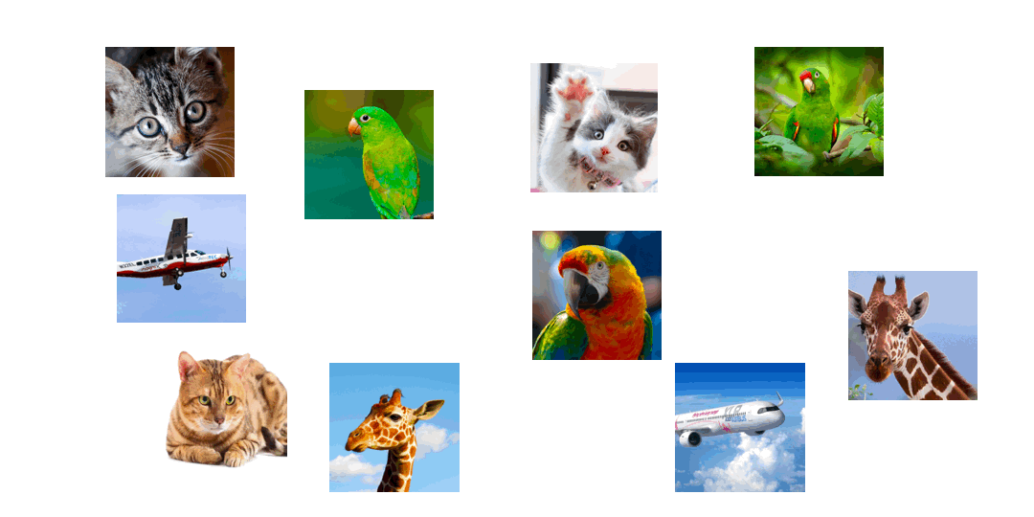
Contrastive Learning
Similar examples should be grouped together and far from other clusters of related examples.

Slide 7
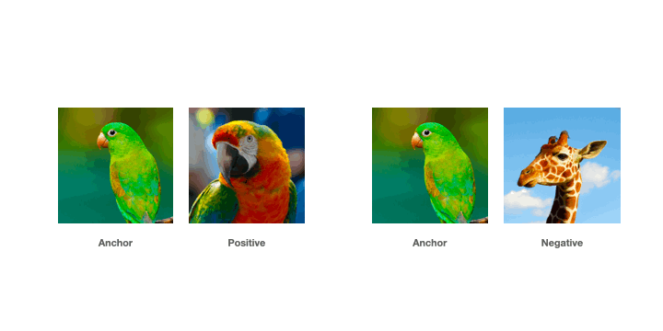
Contrastive Learning
Three key ingredient to achieves Contrastive learning: Positive, Anchor, and Negative representation
To create a positive pair, we need two examples that are similar,
For a negative pair, we use a third example that is not similar.
We don’t know the labels.
How we know whether two images are similar or not?

Slide 8
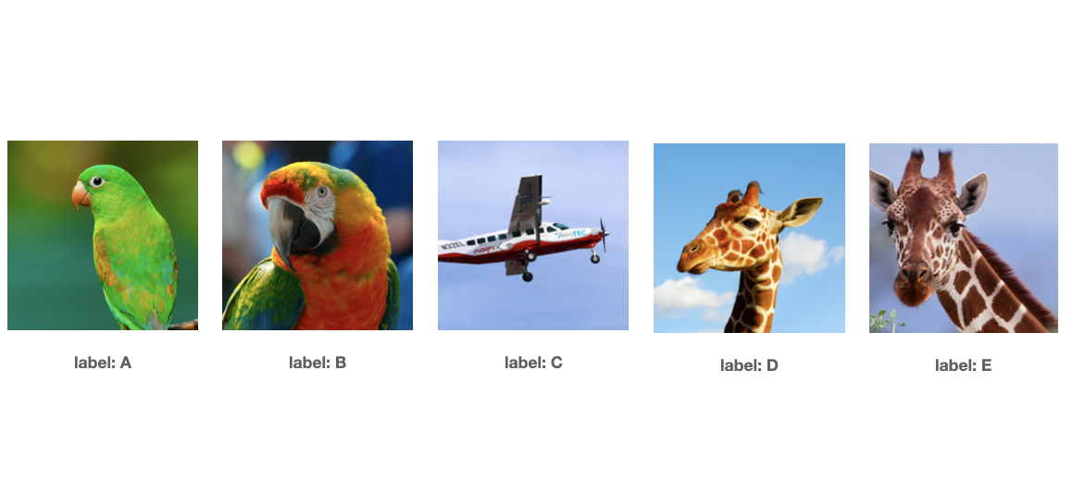
Contrastive Learning
Assume that each image is its own class
Dataset of size N, we now have N labels!

Slide 9
Contrastive Learning
Steps
Method
Step1. Data Augmentation
CPC
AMDIM
ResNet-50
Step2. Choice Encoder
ResNet-50
Tweaks
Step3. Representation extraction
SimCLR, Moco, Swav, BYOL

Slide 10
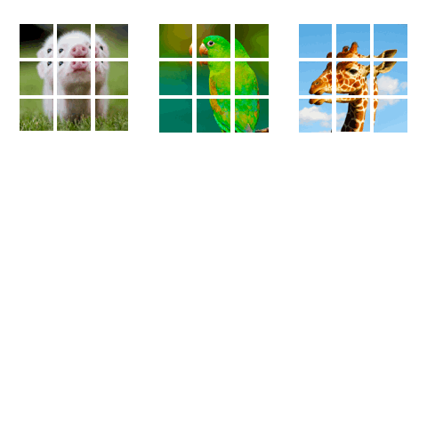
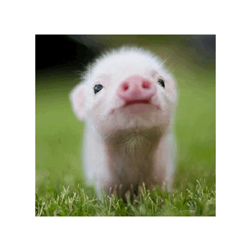
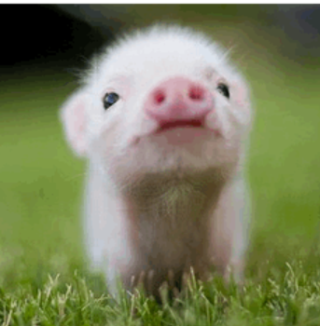
Step.1 Data Augmentation: CPC Generate the anchor, positive and negative examples
CPC Pipeline
(color jitter, random greyscale, random flip,
overlaying sub patches)
This process is applied to a batch of examples, where we can use the rest of the examples in the batch as the negative samples.

Slide 11
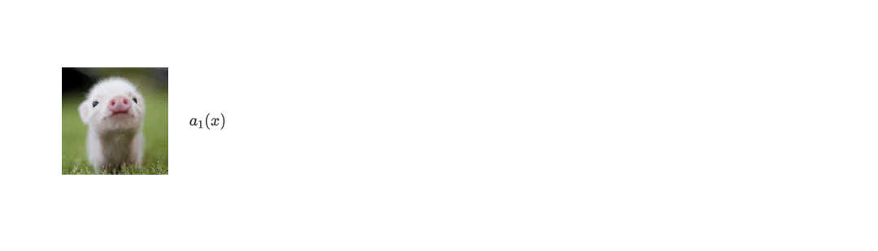
Step.1 Data Augmentation: AMDIM Generate the anchor, positive and negative examples
A data augmentation aims to build representations that are invariant to noise in the raw input.
In contrastive learning, the data augmentation pipeline has a secondary goal which is to generate the anchor, positive and negative examples.
AMDIM Pipeline
After it performs the standard transforms (jitter, flip, etc…), it generates two versions of an image by applying the data augmentation pipeline twice to the same image.

Slide 12
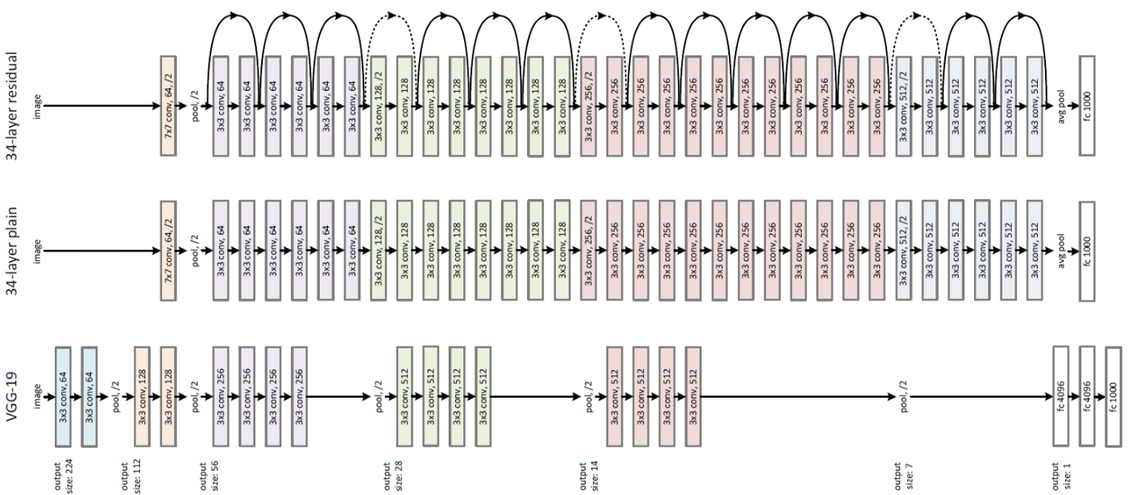
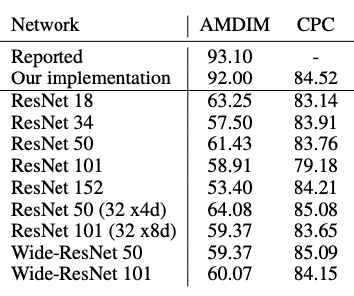
Step.2 Choice Encoder
ResNet-50
ResNet-50 means we can focus on improving the other characteristics to drive improvements as a result of better training methods and not better architectures.

Slide 13
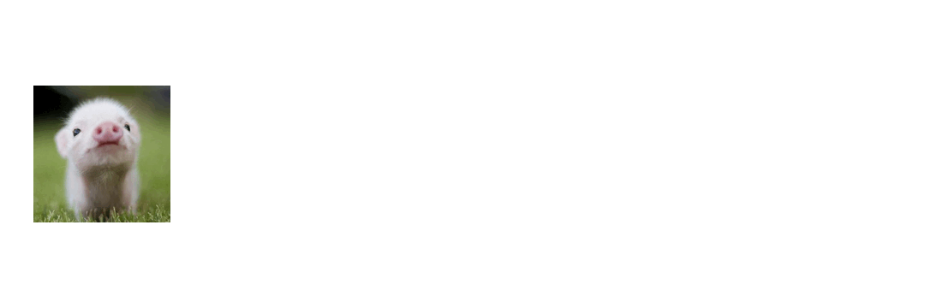
Step.3 Representation extraction: AMDIM
1) AMDIM augmentation pipeline generates two versions of the same image.
2) Each version is passed into the same encoder to extract feature maps for each image. Uses them to make comparisons across spatial scales.
AMDIM
Compare representations across views from feature maps extracted from intermediate layers of a convolutional neural network.

Slide 14
Step.4 Tweak AMDIM: Momentum Contrast (MoCo)
Momentum Contrast
- Contrastive learning as Dictionary Look up
- Large Dictionary: More negative Samples enhance accuracy
- Consistent Dictionary: Stable Training
- Tweak AMDIM with using only last feature map of encoder

Slide 15
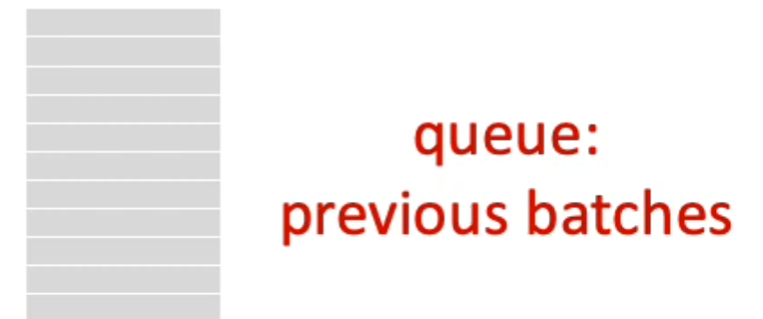
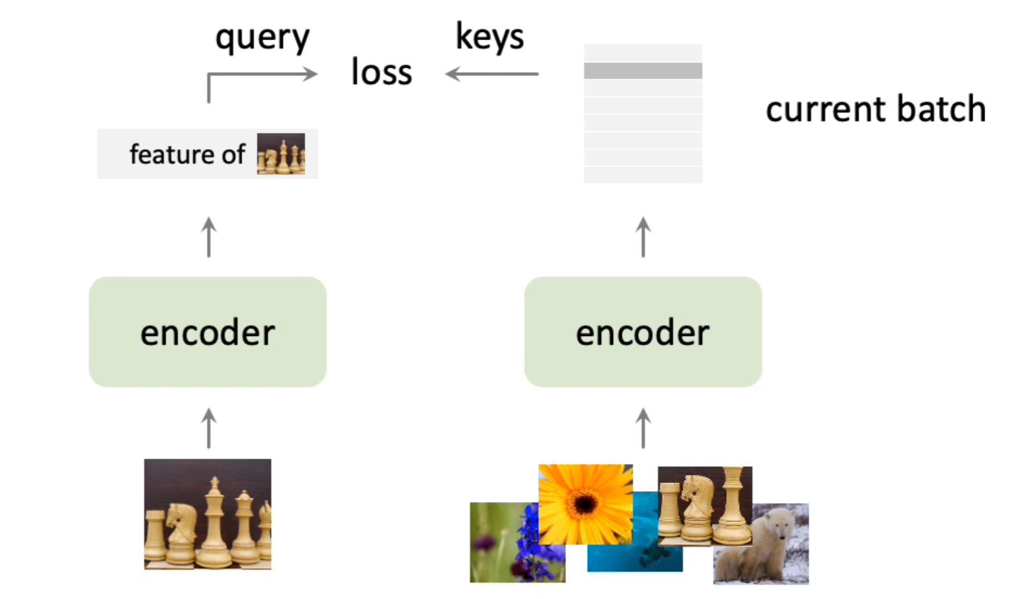
Momentum Contrast: Large Dictionary
Maintain the features in the previous patch as a cue the dictionary consists of the current and previous batches.
=> not limited by the batch size.

Slide 16
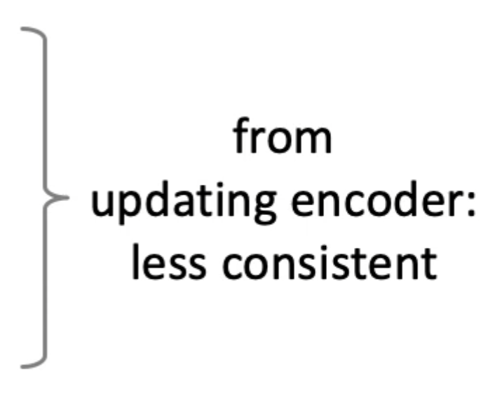
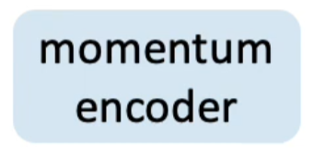
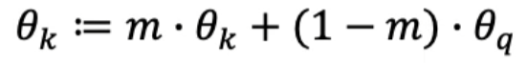
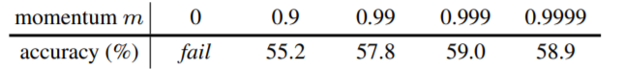
Momentum Contrast: Consistent Dictionary
“Slowly Momentum Encoder”
The features in this dictionary are from an update encoder that covers multiple batches.
=> Less consistent

Slide 17
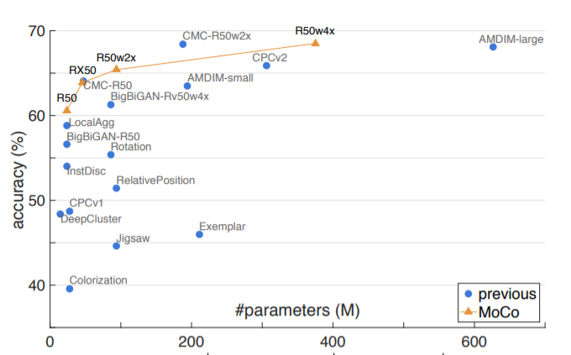
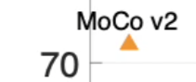
Results: ImageNet Linear Classifiers

Slide 18
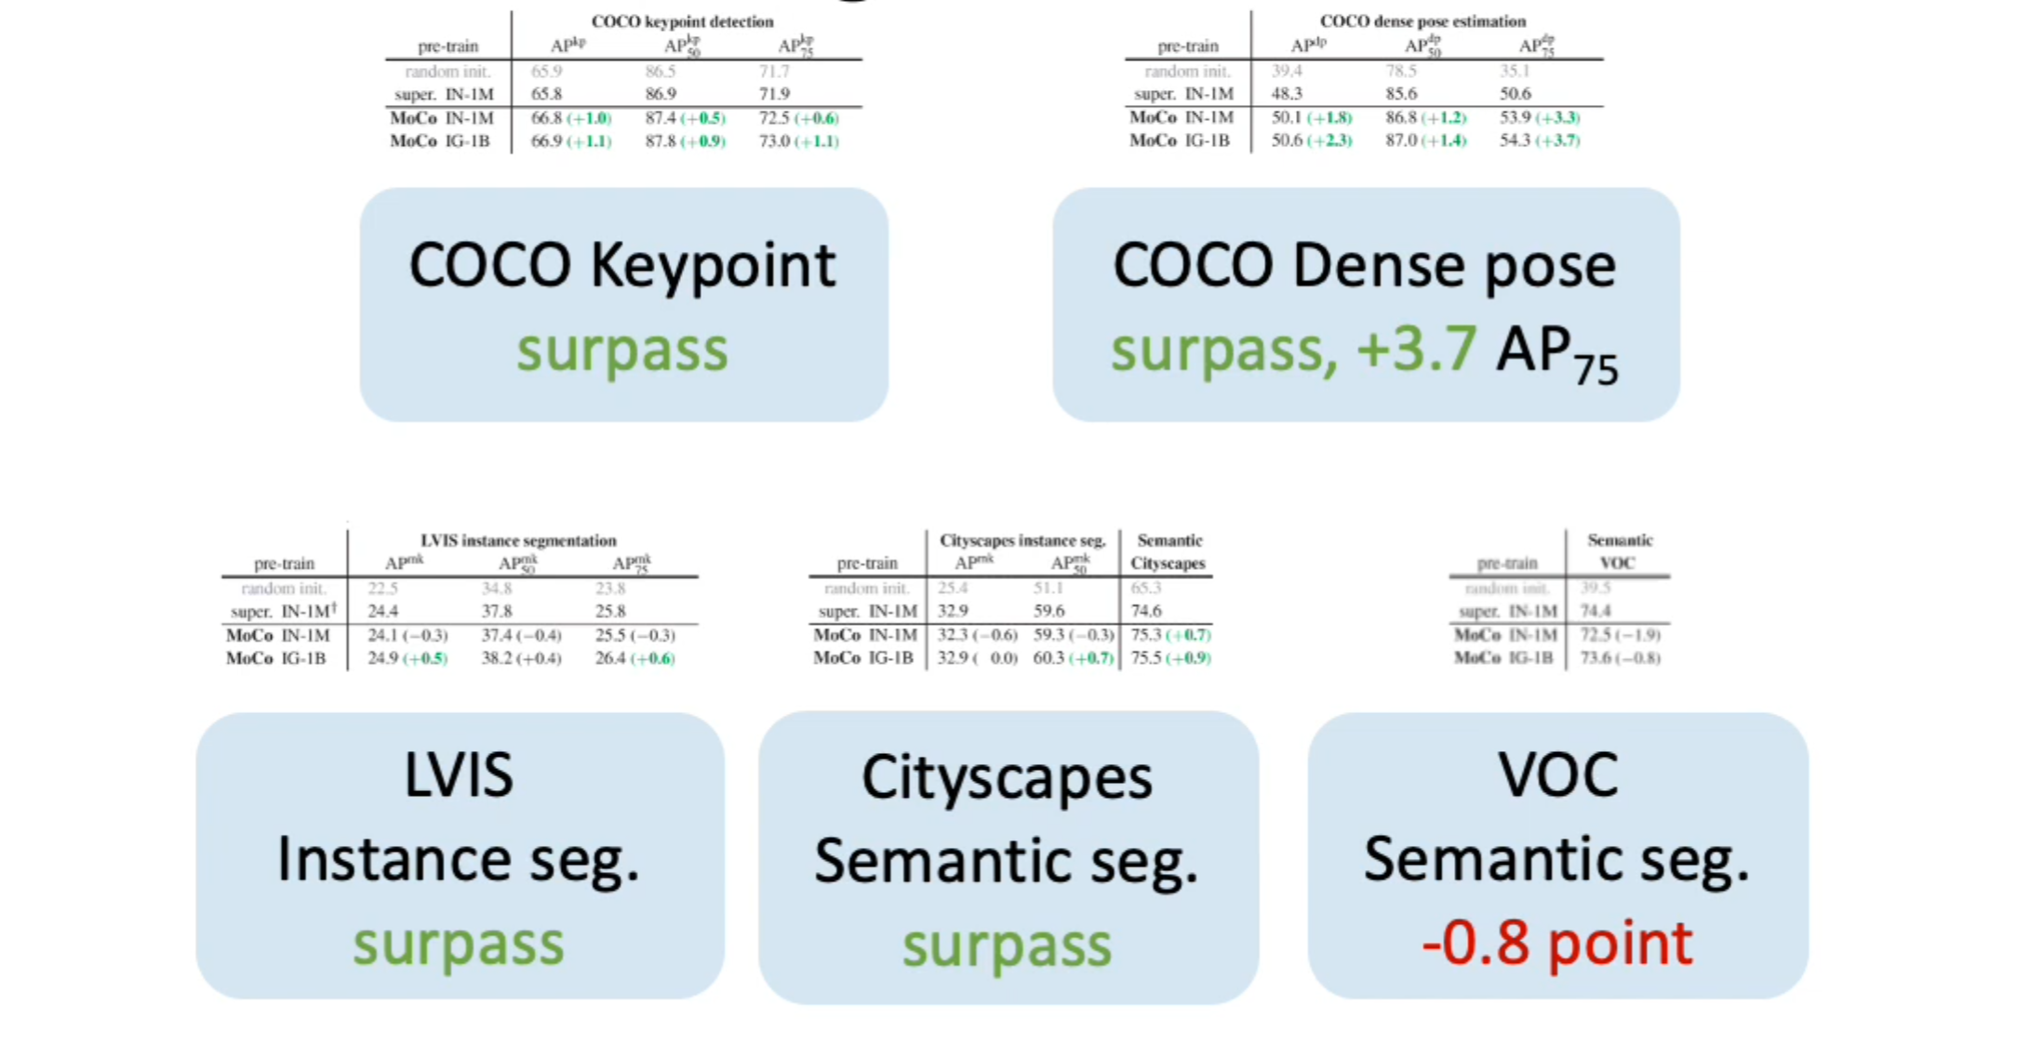
Results: Transferring Features (Unsupervised Pre-Training)

Slide 19
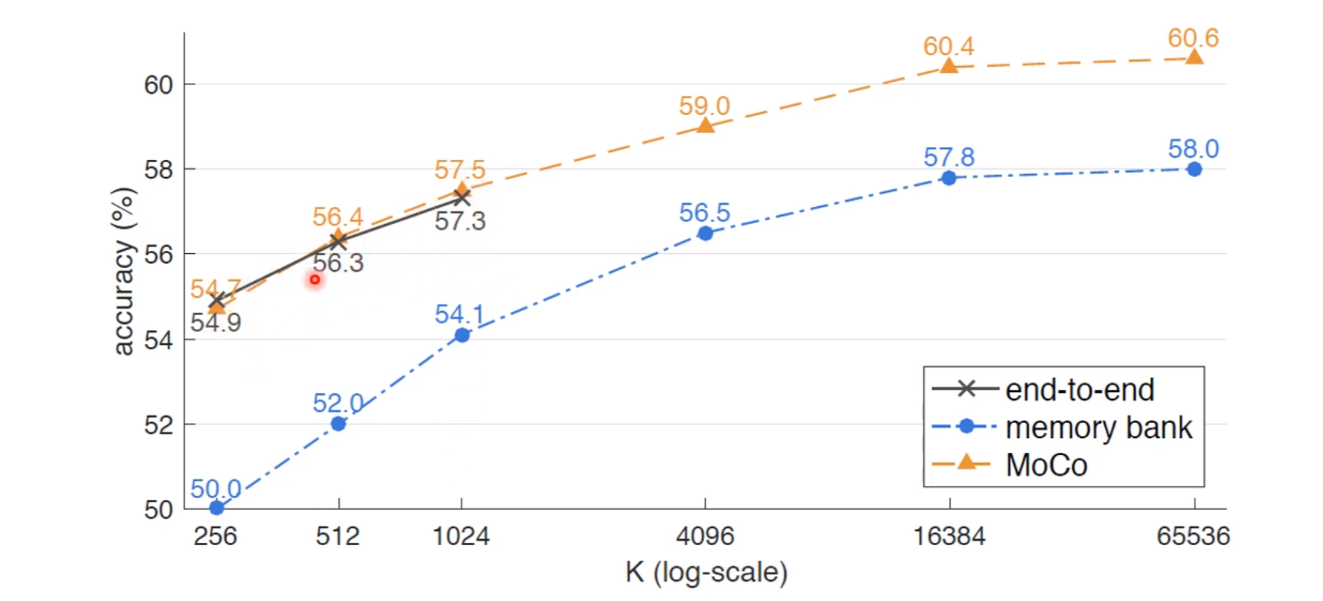
Results: Accuracy Improve via increasing negative samples
Increasing K(Negative Sample) shows improving the accuracy
End-to-End model cannot scale since depends on Batch size

Slide 20
Highlights
Unsupervised pre-training: surpass supervised counterparts

Slide 21
Highlights
Unsupervised pre-training: surpass supervised counterparts
… in 7 vision tasks on detection, segmentation

Slide 22
Highlights
Unsupervised pre-training: surpass supervised counterparts
… in 7 vision tasks on detection, segmentation
… by big margins in some tasks

Slide 23
Highlights
Unsupervised pre-training: surpass supervised counterparts
… in 7 vision tasks on detection, segmentation
… by big margins in some tasks
… scaled out to 1 billion images

Slide 24
Conclusion
Contrastive learning as dictionary look-up
Unsupervised pre-training: surpass supervised counterparts

Slide 25
Thank you
Reviewer: Su Hyung Choi, CVLAB Intern @ Korea University
Momentum Contrast for Unsupervised Visual Representation Learning (CVPR 2020)

